Slide 1
Machine Learning: End-to-End Workflow Using Decision Trees
Nick jones, gfdrr labs
Poverty Gp summer university – July 2019
Credit: Slide deck originally developed with Jon Kastelan (NYU/McKinsey) for the GSURR Machine Learning for Cities workshop. Thanks to Daniel Neill (NYU), Mersedeh Tariverdi (Health GP) and Ran Goldblatt (New Light Technologies) for inputs and comments.

Slide 2
Supervised vs. unsupervised

Slide 3
What is Machine Learning?
Simple definition:
How machines learn rules from examples.
Goal of any machine learning:
Learn patterns from examples
Be able to generalize them to new examples
Supervised and unsupervised machine learning:
In both cases learning is achieved through examples!

Slide 4
What is Machine Learning?
Formal definition:
A program is said to learn from experience E with regard to task T and performance measure P, if its performance on task T improves with experience.
# | Task | Experience | Performance Measure
1 | Recognize handwritten digits | Set of digits with labels | Percent of correct recognitions
2 | Predict length of hospital stay | Patient histories | Mean prediction error
3 | Recommend Netflix shows | Viewing histories | # users viewing show

Slide 5
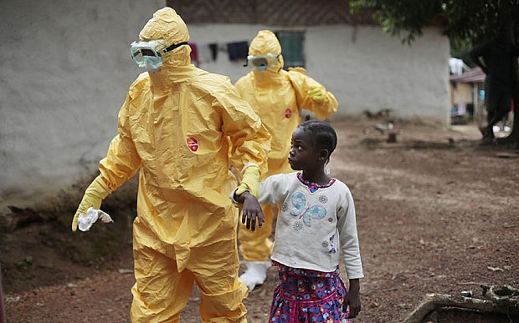
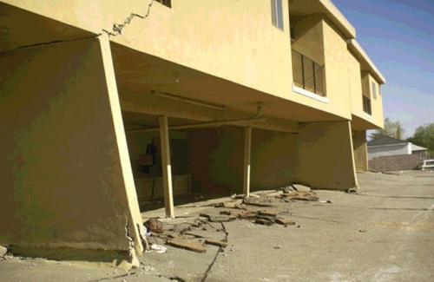
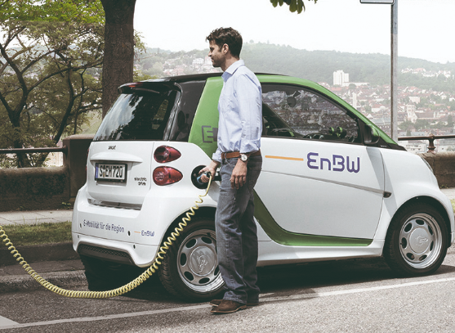
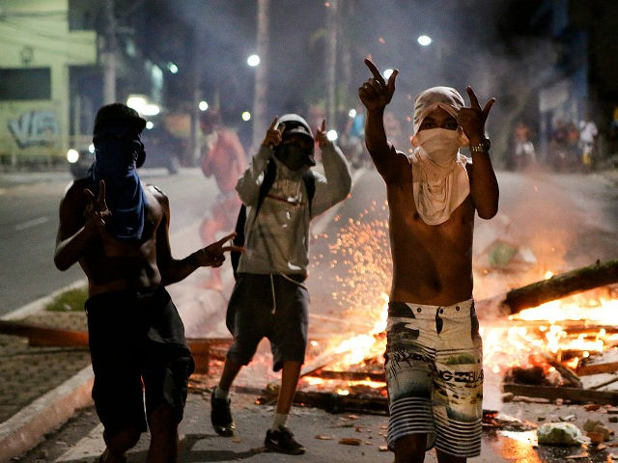
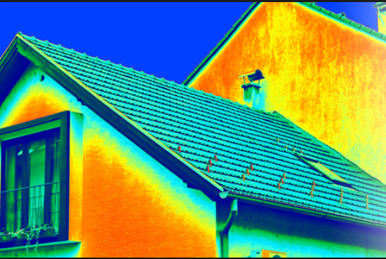

Some motivating examples
Early detection of disease outbreaks
Identifying vulnerable buildings for retrofit
Predicting transport demand
Preventing violent crime
Reducing CO2 emissions
Targeting fire
risk inspections
Acknowledgment: D. Neill, Machine Learning for Cities, CUSP NYU
Notes:
Not reinventing the wheel here.. Lots of great content from Daniel Neill’s slides - let’s work out which parts convey the message best (we need to summarize)

Slide 6
Five main steps:
An approach to model fitting
Use Case & Data
Model training
Tune (calibrate)
Predict
Evaluate
Determine question of interest, get informative data.
Split data into training and test sets. Fit model to training set.
Tune model parameters
Use the tuned model to form predictions about your test set
Compare the predictions with the actual values for the test set
Variables of interest are categorical, supported by classification
or numerical, supported by regression

Slide 7
Unsupervised Learning
The only thing we have is input data.
Labels are not provided by a supervisor.
What does an unsupervised algorithm do?
Extract patterns in the data.
Create clusters whose members are similar (based on some set of measurements).
Example: Take raw data on visitors to my website
Segment them into groups that share same characteristics; target ads.

Slide 8
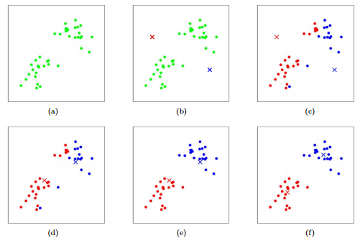
First iteration
Original dataset
Initial random centroids
Second iteration
K-means clustering
(1) Create initial cluster centers at random
(2) Assign points to nearest cluster
(3) Move centroid to mean of assigned points
→ Repeat several times
(4) Assign outputs
Image credit: Chris Piech, Stanford Univ. (CS 221)

Slide 9
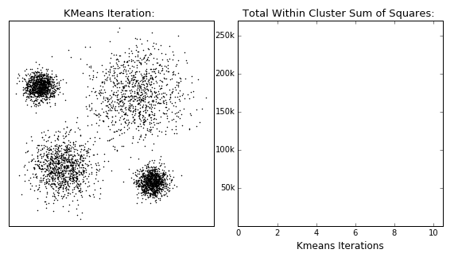

Slide 10
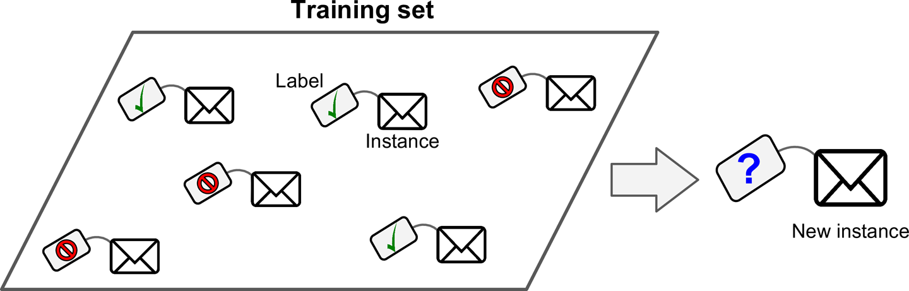
Supervised Learning
The machine learns from examples that have already been labelled.
Each example has input values (attributes) and an output value.
Example: A spam classifier learns rules from this training set of emails¹
Goal:
Use known output values to learn the patterns of the input.
Predict the output value of new examples.
Image credit: Géron, Hands-On Machine Learning

Slide 11
Supervised Learning algorithms
Linear regression
Support Vector Machines
Learns a decision boundary (linear or non-linear)
Decision trees and Random Forest
High predictive power, requires less data preparation.
Neural networks
• Algorithms inspired by structure and function of the brain.
• Scalable, highly accurate on tasks like image recognition.
Fast to train, effective on high-dimensional data.
Models output as linear combination of inputs
Suits complex, medium-size datasets
Builds flow-chart style rules that maximize information gain

Slide 12
Decision Trees
Tree models represent a sequence of choices leading to an outcome.
Start in the root node. Each branch represents the outcome of a test.
Terminal nodes show the outcome of decisions taken.
A good decision tree reveals the correct answers in as few questions as possible.
For ML, we select the questions using decision rules.

Slide 13
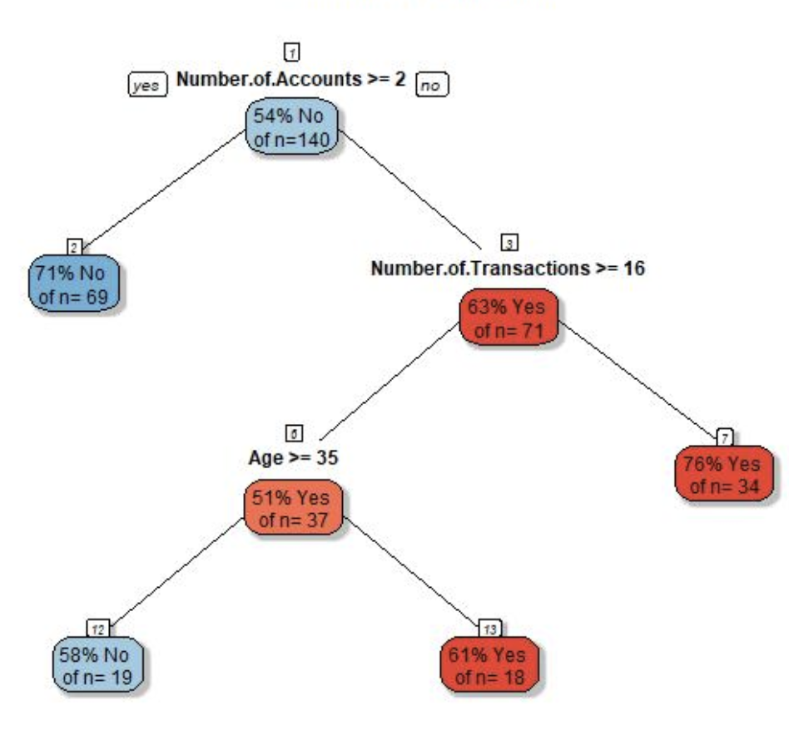
Classification and Regression Trees
Example: Using data from 100,000 past customers, a bank wants to classify current customers as ‘stay’ or ‘churn’.
1. Start with all examples in the root node.
2. Find the true/false question that most effectively divides into pure classes.
Format:
Is feature k greater than threshold t (eg. ‘age > 35?’)
Select the k,t combination that scores best on your decision rule (eg. Gini impurity)
3. Continue splitting until all leaf nodes are pure.
Image credit: analyticsvidhya.com

Slide 14
Building a model

Slide 15
Use Case & Data
Model training
Tune
Predict
Evaluate

Slide 16
Use Case & Data
Model training
Tune
Predict
Evaluate

Slide 17
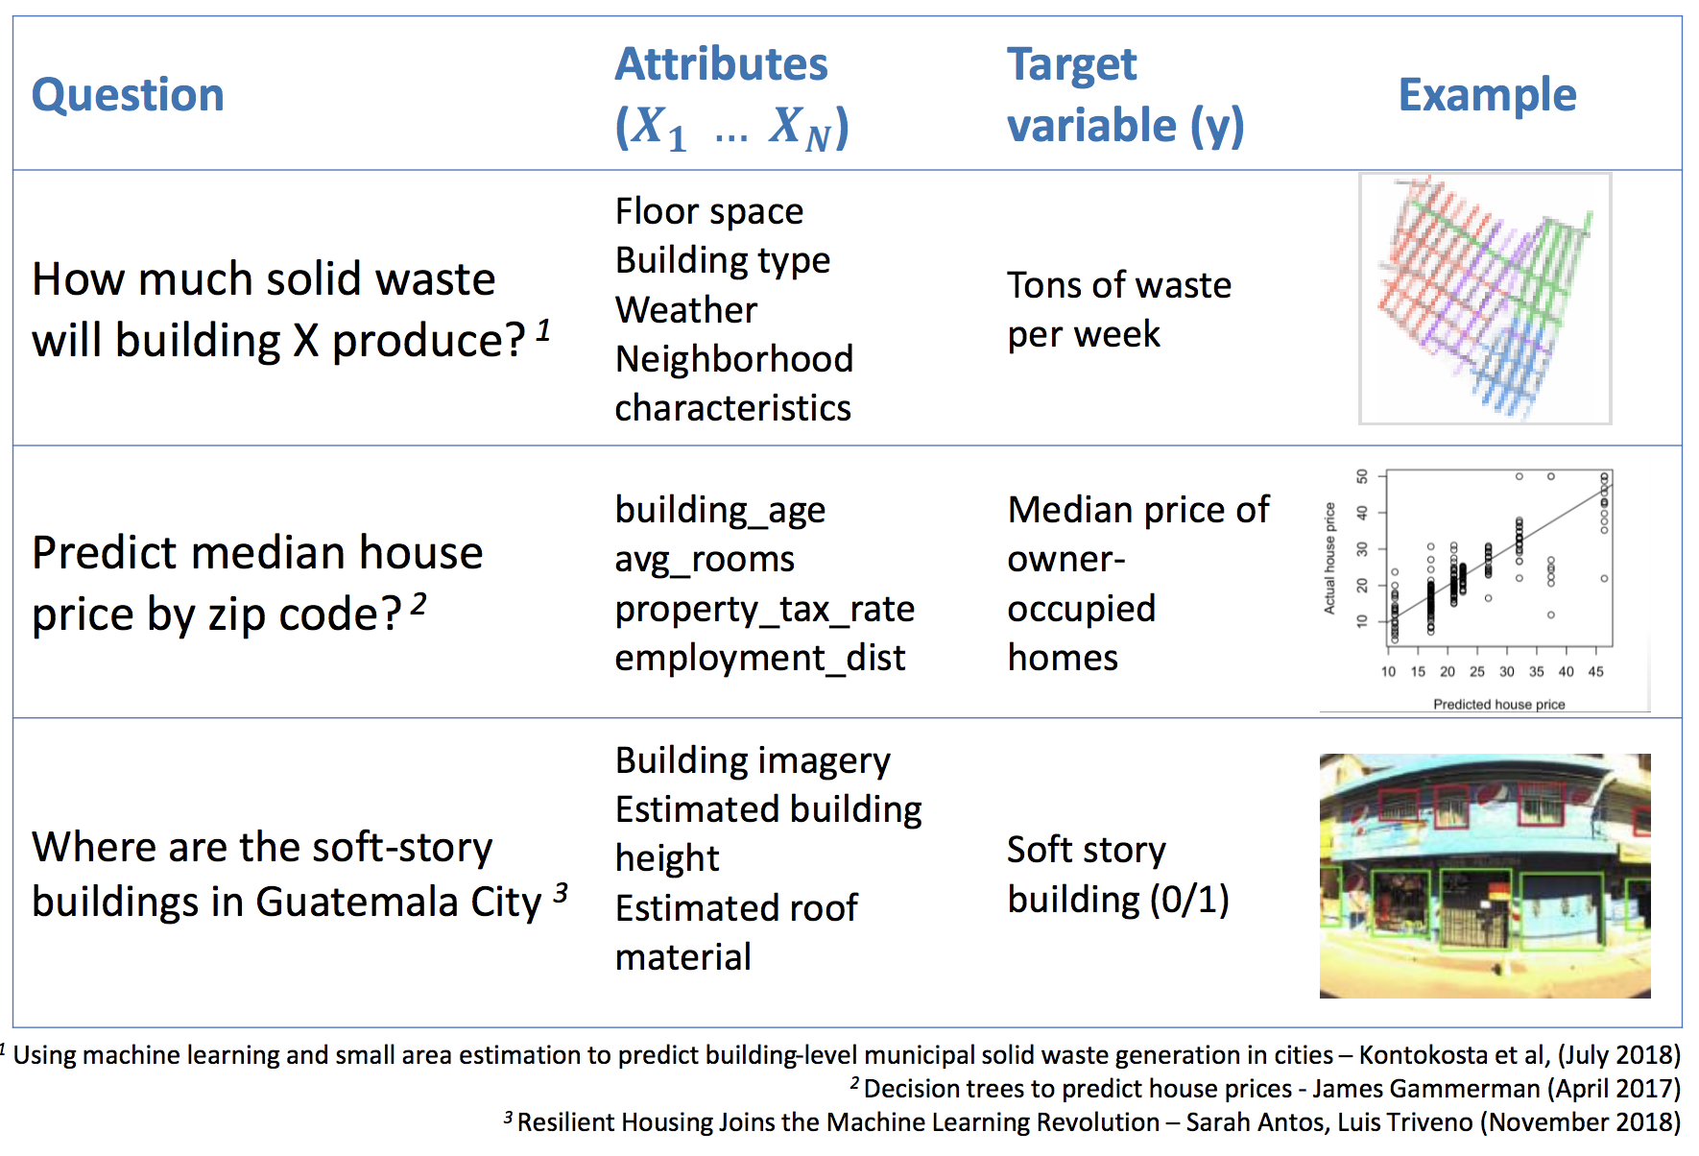
Build labeled dataset for question of interest

Slide 18
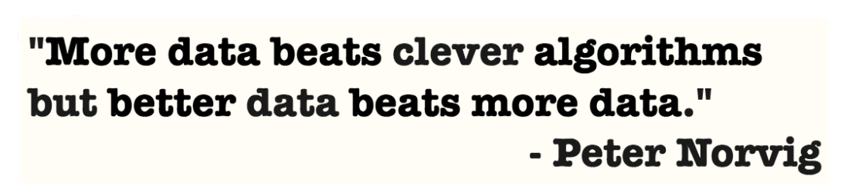
Data collection and cleaning can take two-thirds of the time of an analytics project:
Create a good set of attributes (features)
Collection and aggregation
Data sharing, privacy
Missing data
Merging across spatial granularities
Building training data is hard work: be creative

Slide 19
Use Case & Data
Model training
Tune
Predict
Evaluate

Slide 20
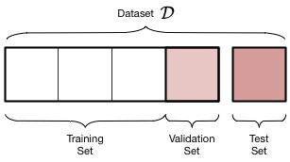
When fitting ML algorithms, it is common to separate data into training and test sets
Split training and test data
Split the dataset (e.g. 70/30 ratio)
Build model on
the training set
Evaluate model on
the test set
Dataset
Training set
(70% of records)
Test set (30%)
Image credit: D. Ziganto “Standard Deviations” blog

Slide 21
Use Case & Data
Model training
Tune
Predict
Evaluate

Slide 22
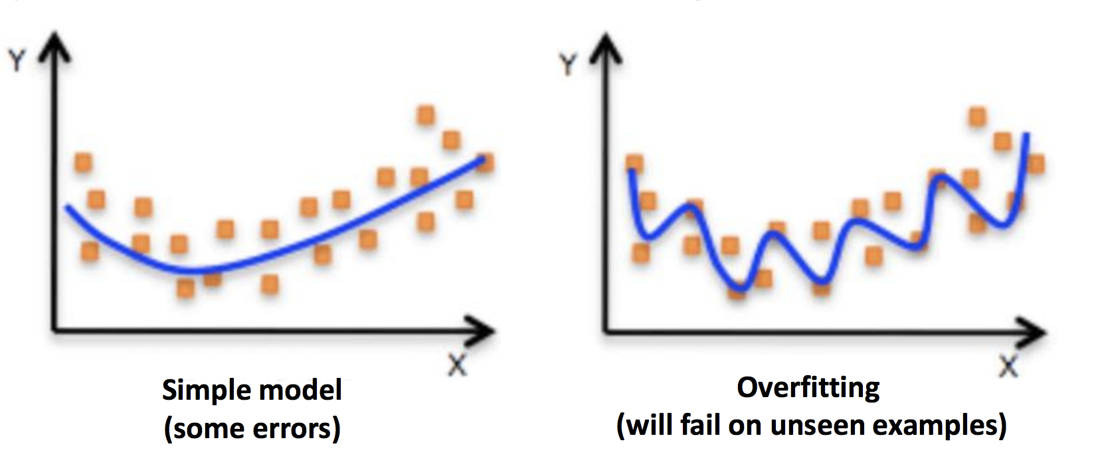
Complexity vs. accuracy
We can build models of lower or higher complexity by changing their hyper-parameters.
Aim for the ‘sweet spot’ that maximizes performance but avoids overfitting.
* Overfitting: a complex model that memorizes the test set (including noise in it) but fails to generalize to new data.

Slide 23
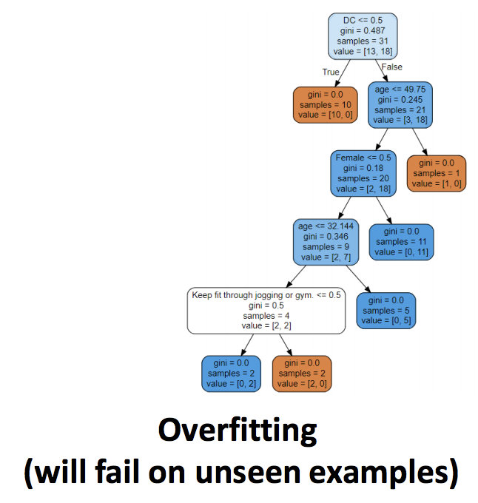
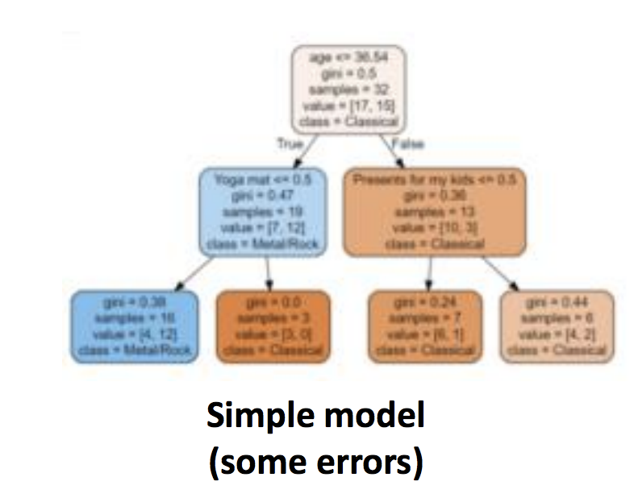
Complexity vs. accuracy
We can build models of lower or higher complexity by changing their hyper-parameters.
Aim for the ‘sweet spot’ that maximizes performance but avoids overfitting.
* Overfitting: a complex model that memorizes the test set (including noise in it) but fails to generalize to new data.

Slide 24
Use Case & Data
Model training
Tune
Predict
Evaluate

Slide 25
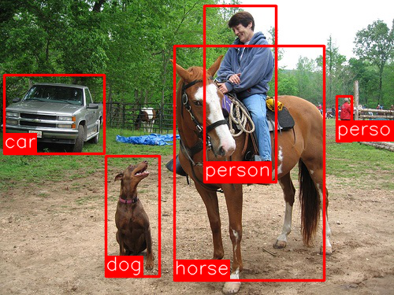
With the model tuned and fitted to training data, we can predict outcomes for test set, ensure its performance is satisfactory, and deploy.
Make predictions
Figure: Object detection in images
Image: Faster R-CNN: Towards Real-Time Object Detection with Region Proposal Networks (2016)

Slide 26
EXAMPLE:
Predicting mode of transport and music taste

Slide 27
Decision tree model for transport planning
Scenario: The World Bank has hired a cohort of 100 new staff, who start this summer. GSD needs to decide how many bike racks or parking spaces to build for them.

Slide 28
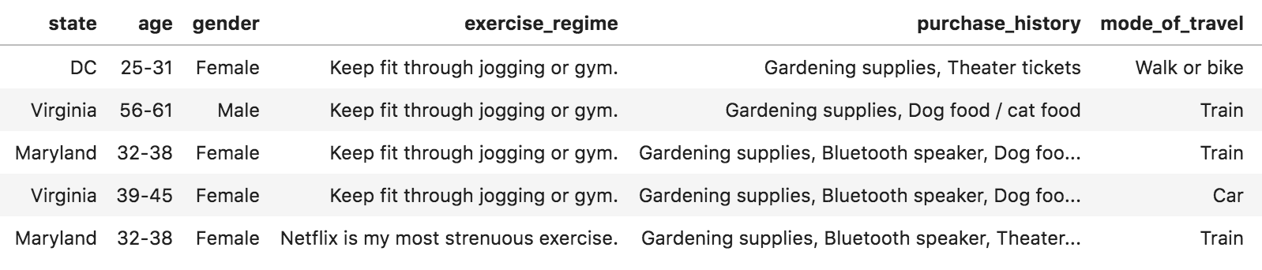
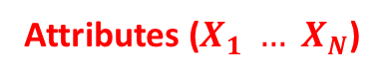
Decision tree model for transport planning
Scenario: The World Bank has hired a cohort of 100 new staff, who start this summer. GSD needs to decide how many bike racks or parking spaces to build for them.
Attributes ($X_{1} … X_{N}$)
Target variable (y)
From this training set, construct set of rules to predict mode of transport for unseen examples.

Slide 29
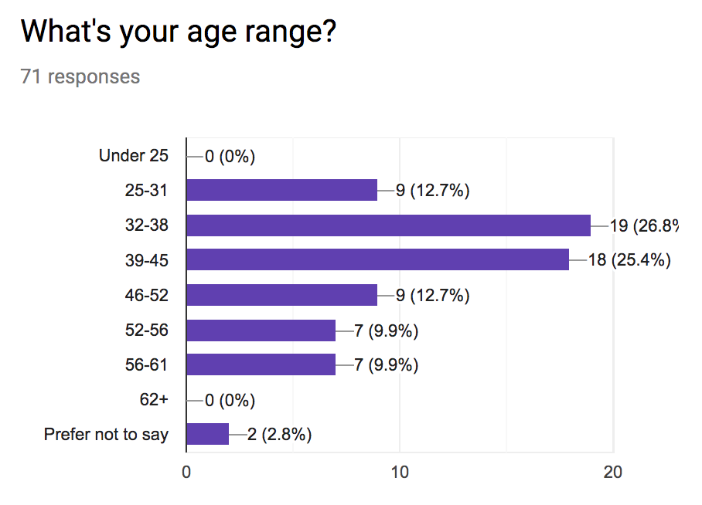
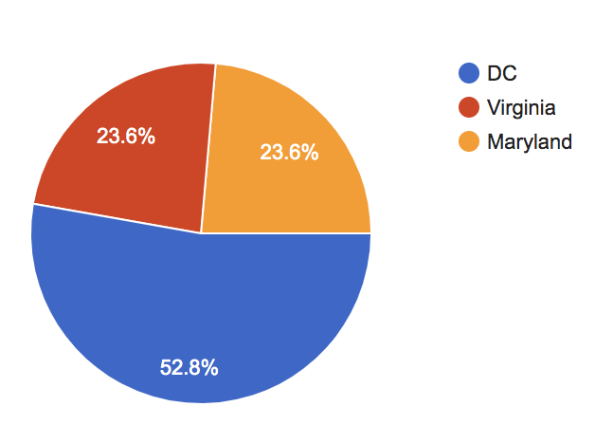
Decision tree model for transport planning
Scenario: The World Bank has hired a talented cohort of 100 new staff, who start after Thanksgiving. GSD needs to decide how many bike racks or parking spaces to build for them.
Mix of home states and ages

Slide 30
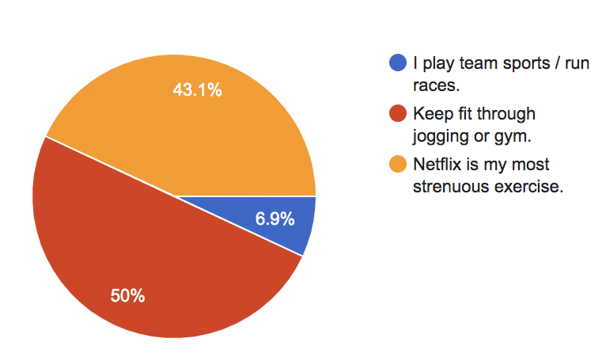
Decision tree model for transport planning
Scenario: The World Bank has hired a talented cohort of 100 new staff, who start after Thanksgiving. GSD needs to decide how many bike racks or parking spaces to build for them.
High enjoyment of Netflix

Slide 31
Decision tree:
Transport
Live outside DC?
[37 car-train/
10 walk-bike]
Gini = 0.33
True
False
Younger than 38.5?
[23 CT, 0 WB]
Gini = 0.00
[14 CT, 10 WB]
Gini = 0.49
MAJORITY CLASS
Walk-bike
True
False
Car-train
Theater tickets?
Kids presents?
[8 CT, 5 WB]
Gini = 0.47
[6 CT, 5 WB]
Gini = 0.50
True
False
True
False
[4 CT, 0 WB]
Gini = 0.00
[4 CT, 5 WB]
Gini = 0.49
[5 CT, 0 WB]
Gini = 0.00
[1 CT, 5 WB]
Gini = 0.28
Predict car-train (100% confidence)
Predict walk-bike (56% confidence)

Slide 32
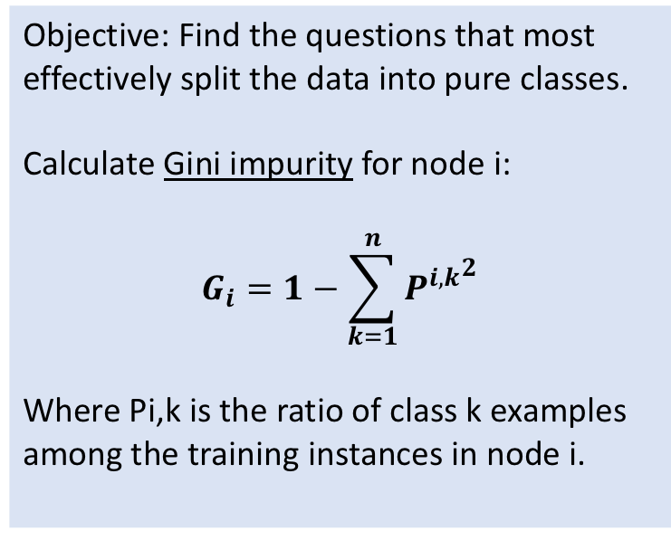
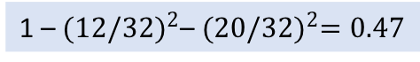
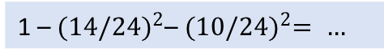
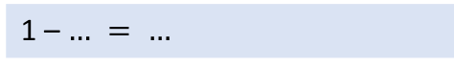
Break-out: Calculate node purity by hand
Example:
Objective: Find the questions that most effectively split the data into pure classes.
Calculate Gini impurity for node i:
$$G_{i}=1−\sum_{k=1}^{n}{{P^{i,k}}^{2}}$$
Where Pi,k is the ratio of class k examples among the training instances in node i.
[37 car-train; 10 walk-bike]
Gini = …
1 – ${(12/32)}^{2}\text{– }{(20/32)}^{2}=0.47$
Your turn:
[14 car-train; 10 walk-bike]
Gini = …
1 – ${(14/24)}^{2}\text{– }{(10/24)}^{2}= …$
[2 car-train; 6 walk-bike]
Gini = …
1 – $… = …$

Slide 33
Decision tree:
Music choice
Female?
[34/14]
Gini = 0.4
True
False
Age < 31.5?
Age < 38.5?
[24,7]
Gini = 0.35
[10,7]
Gini = 0.36
True
False
False
True
Age < 45.5?
[3,0]
Gini = 0.00
[21,7]
Gini = 0.38
[2,3]
Gini = 0.48
[8,4]
Gini = 0.44
True
Kids presents?
[2,1]
Gini = 0.48
[6,3]
Gini = 0.48
True
False
[2,3]
Gini = 0.48
[4,0]
Gini = 0.50

Slide 34
Use Case & Data
Model training
Tune
Predict
Evaluate

Slide 35
Ensemble models and feature importance

Slide 36

Random forests
Build multiple decision trees.
Each tree has:
A randomized subset of the features
A random subset of training data (with replacement).
Predictions averaged across the trees.
K₁
K₂
K₃
k

Slide 37
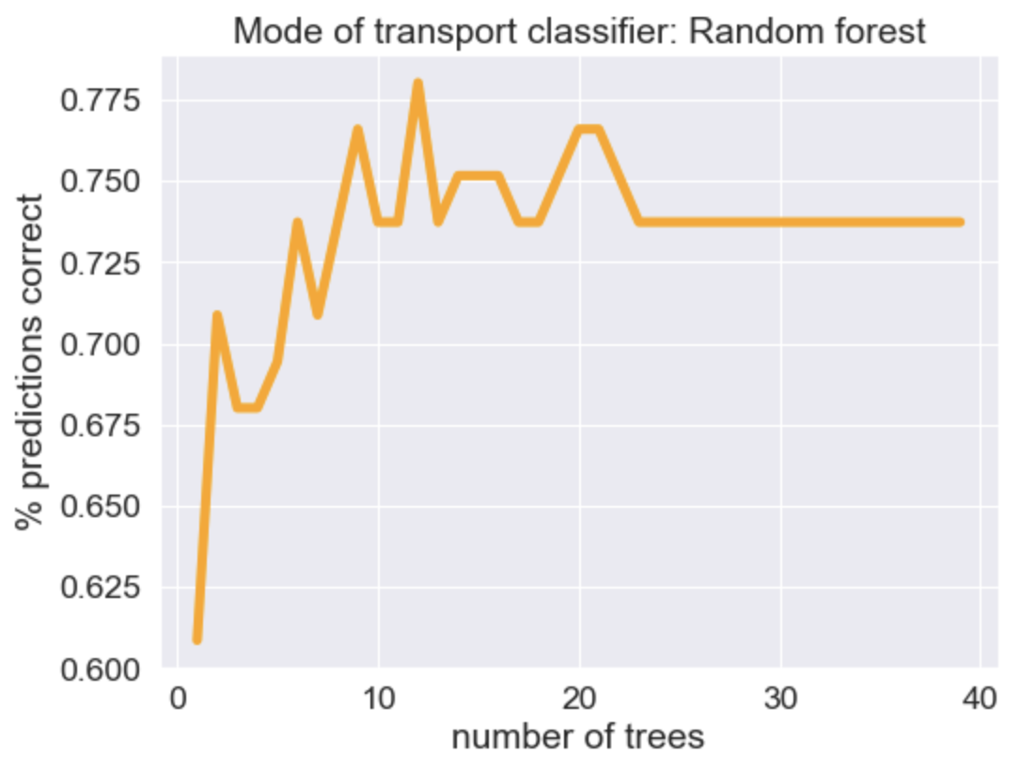
Random forests
Agnostic to feature scaling, robust to the inclusion of correlated or irrelevant features.
➢Choose the parameter combination that maximizes prediction accuracy on unseen data.

Slide 38
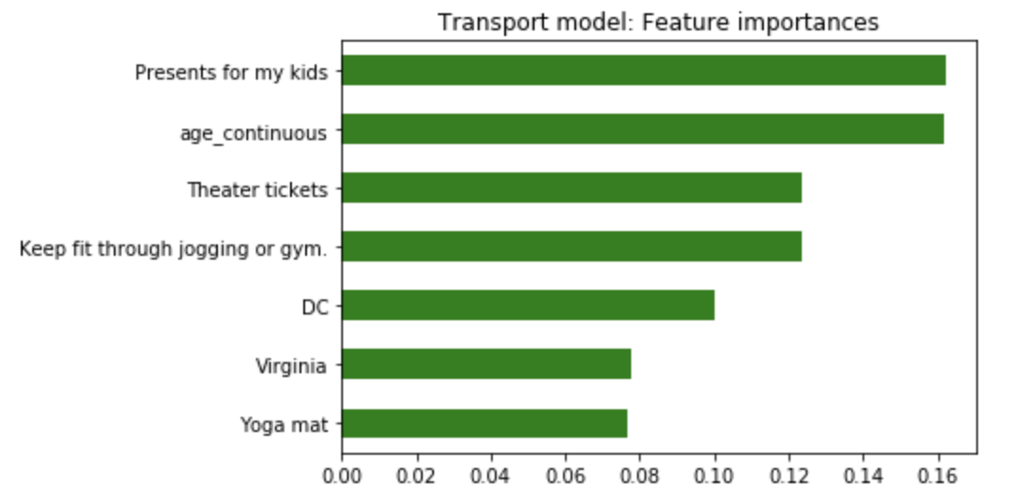
Feature importance

Slide 39
Imagining use cases, identifying training data

Slide 40
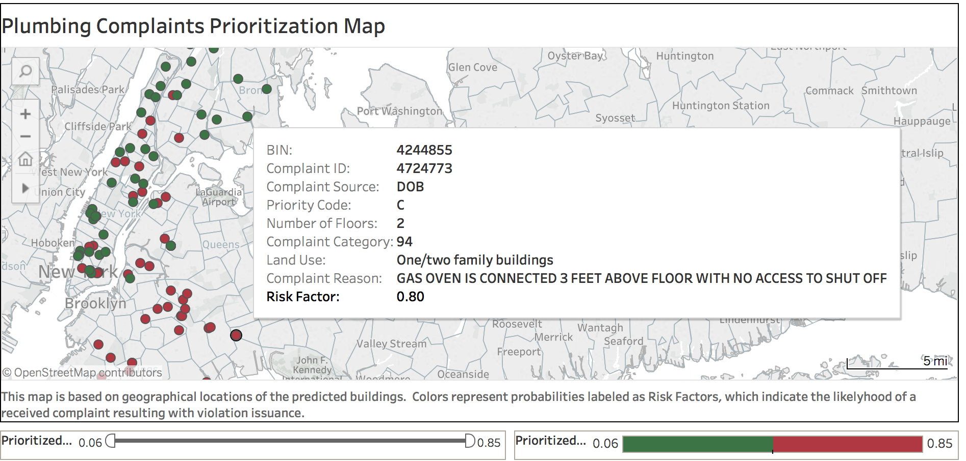
Question: Could an algorithm reduce risk in the built environment by sending building inspectors to the most dangerous cases first?
Case 1: Prioritize building inspections
Challenges:
Buildings data fragmented across agencies.
Time-consuming to build training set.
Management initially hesitant about ML. Deploying as an interactive dashboard helped make outputs intuitive.
Data used:
Building characteristics (year built, number of floors, retail/residential)
Neighborhood demographics (median income, percent homes owner-occupied)
City records of prior code violations and construction filings.
Source of the complaint or referral.
Outputs / visualisation:
Best model is a Gradient Boosting Classifier. Trees: 750; max depth 9.
Trained on data from 2015-2017.
Achieves 70% accuracy on the unseen test data (1,200 building complaints from 2017-2018).

Slide 41
Question:
Template – ML use case
Challenges:
Outputs:
Training data required:

